Slide 1
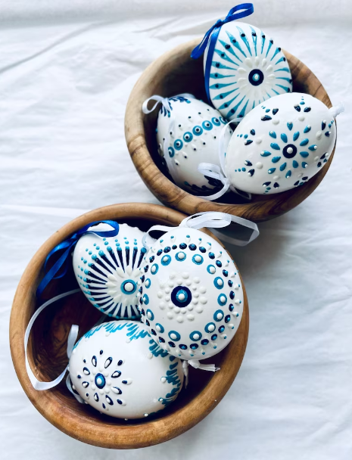
CREATE YOUR OWN
UKRAINIAN
EASTER EGG!
SATURDAY, MARCH 16, 10-12
BSL Library
REGISTRATION IS REQUIRED
Register at Front Desk or
Online via Our
Events Calendar
Come experience
the incredible Ukrainian art of
"writing on eggs" (called "Pysanky")!
Instructor Shawn will be here to discuss the fascinating history of these eggs and what ancient peoples were
actually saying when they wrote on them! She'll then lead the class through the steps of using beeswax, a candle,
and a special tool to create your own "story egg."
The Kit fee for this
class will be between
$5-10 (payable at class)
and covers the
supplies needed.
You will leave with your
"hand-written“ egg—
just in time for
Easter!

